Slide 1
Sans Incident Response plan
Danny Nguyen and Mentor John Danahey

Slide 2
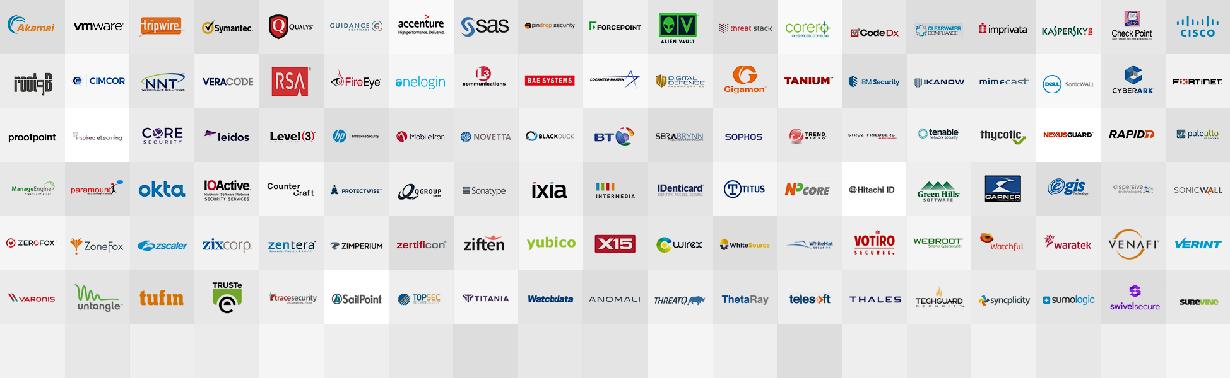
Vendors

Slide 3
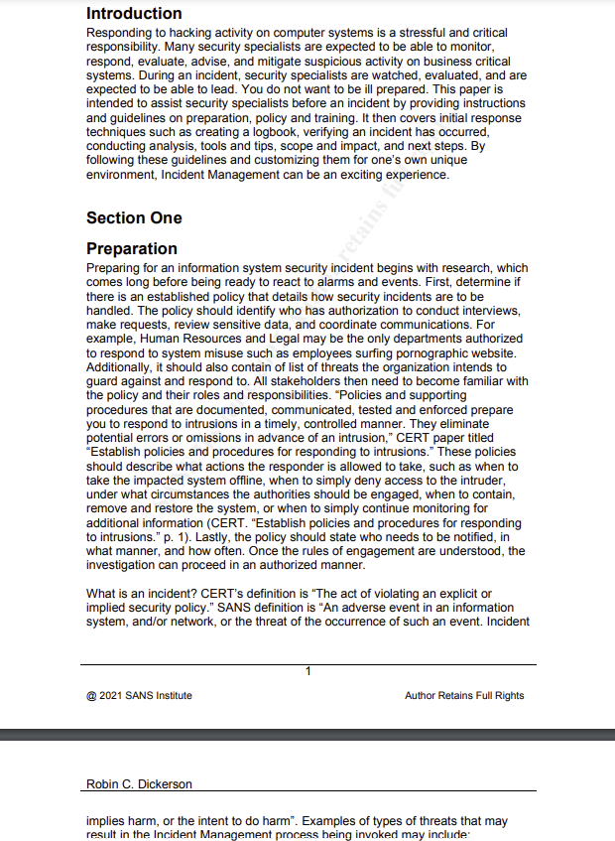

Slide 4

Boring, wasn’t it? Don’t get sucked into the business vortex
There are lots of vendors, and pages of these response plans that an employee is expected to go through. I went through the hours of suffering so that you all didn’t have to.

Slide 5



RESEARCH!
Know it all
Responders
Previous plans?
Access to Info?
Enforces rules?
Documented Procedure
Have a role (secret)
When to escalate

Slide 6



What to do
Practice
Save a Headache
Handle Specific attacks
Report to whom
Do nothing
Pen-Testing and tabletop exercises are recommended.
Document all steps.

Slide 7

Learning is doing
Follow all steps before
Force interactions with the team
Make exercises close to real as possible.
Keep sensitive information safe

Slide 8



Investigate
Verify​
Things to do
Record​
Make sure an attack occurred
What happened as a result
Determine how it was done
If the attack is active, avoid alerting.
Contact authorities when its right
Write everything (outcomes, entry, who was interviewed, things affected, etc.)

Slide 9

Check those logs
Windows
Unix
Network
Something out of place in security logs?
Logged users, login attempts?
Suspicious times? Apps? Users?
“Analyze all information to characterize the intrusion.” -SANS

Slide 10

Conduct Interviews
Admin
Anyone who has access
Employees
New, Old, Anyone affected/involved
Question
Any suspicious logins, changes, who else has access?

Slide 11

Narrow it down
Alerts and System Reports
User Behavior
Unexpected processes
Modification
Too much traffic or inactivity.
Failed Logins?
Unusual processes?
Weird times on and inactive?

Slide 12

Tools Tools Tools
Get them, learn them
Network Mapper
Vulnerability Scanner
Sniffers

Slide 13

Final Incident Report
Damage summary and determined method of entry
Make sure systems on same network or have similar vulnerabilities are protected.
Every little thing is documented and learned from
Keep advantages away from the attacker

Slide 14
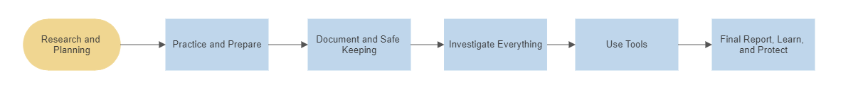
Takeaway
These big names and their endless pages of protocols mean nothing if most important thing isn’t considered. The people.

Slide 15
Thank you John and MassCyber Center
Danny Nguyen
dnguyen1@student.Framingham.edu
https://github.com/BakedNuggets

